Slide 1
Programming Fundamentals
By
Shazmeen Batool

Slide 2
Previous Lecture
File Stream Objects
Setting Up a Program for File Input/Output
Creating a File Object and Opening a File
Closing a File
Writing Data to a File

Slide 3
Today’s Lecture
Reading Data from a File
The Read Position
Reading Numeric Data From a Text File
Using Loops to Process Files
Detecting the End of the File
Testing for File Open Errors
Letting the User Specify a Filename

Slide 4
Reading Data from a File
The ifstream class can be used to read data from a text file.
The >> operator not only reads user input from the cin object, but also data from a file.
Assuming inputFile is an if stream object, the following statement shows the >> operator reading data from the file into the variable name:

Slide 5
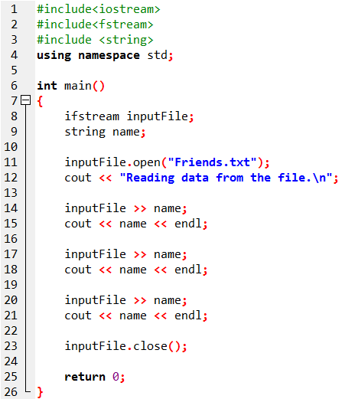

Example

Slide 6
The Read Position
When a file has been opened for input, the file stream object internally maintains a special value known as a read position.
A file’s read position marks the location of the next byte that will be read from the file.
When an input file is opened, its read position is initially set to the first byte in the file.
So, the first read operation extracts data starting at the first byte. As data is read from the file, the read position moves forward, toward the end of the file.

Slide 7
The Read Position
Keep in mind that when the >> operator extracts data from a file, it expects to read pieces of data that are separated by whitespace characters (spaces, tabs, or newlines).
When the statement in line 14 executes, the >> operator reads data from the file’s current read position, up to the \n character.
The data that is read from the file is assigned to the name object.
The \n character is also read from the file, but is not included as part of the data. So, the name object will hold the value “Shazmeen" after this statement executes
S | h | a | z | m | e | e | n | \n | A | l | i | \n | A | y | e | s | h | a | \n
Read Position

Slide 8
The Read Position
The file’s read position will then be at the location:
When the statement in line 17 executes, it reads the next item from the file, which is “Ali", and assigns that value to the name object. After this statement executes, the file’s read position will be advanced to the next item.
S | h | a | z | m | e | e | n | \n | A | l | i | \n | A | y | e | s | h | a | \n
Read Position
S | h | a | z | m | e | e | n | \n | A | l | i | \n | A | y | e | s | h | a | \n
Read Position

Slide 9
The Read Position
When the statement in line 20 executes, it reads the next item from the file, which is “Ayesha", and assigns that value to the name object. After this statement executes, the file’s read position will be advanced to the end of the file.
S | h | a | z | m | e | e | n | \n | A | l | i | \n | A | y | e | s | h | a | \n
Read Position

Slide 10
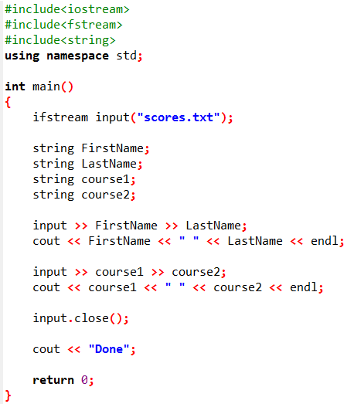

Example

Slide 11
Reading Numeric Data From a Text File
Remember that when data is stored in a text file, it is encoded as text, using a scheme such as ASCII or Unicode.
Even if the file contains numbers, those numbers are stored in the file as a series of characters.
Fortunately, you can use the >> operator to read numeric data from a text file, into a numeric variable, and the >> operator will automatically convert the data to a numeric data type.

Slide 12
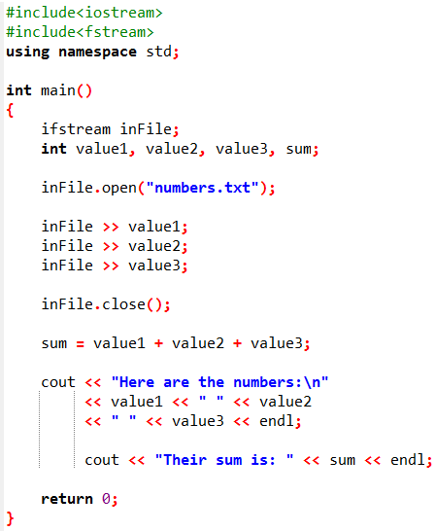

Example

Slide 13
Using Loops to Process Files
Although some programs use files to store only small amounts of data, files are typically used to hold large collections of data. When a program uses a file to write or read a large amount of data, a loop is typically involved.
The program in the next slide gets sales amounts for a series of days from the user and writes those amounts to a file named Sales.txt. The user specifies the number of days of sales data he or she needs to enter.

Slide 14
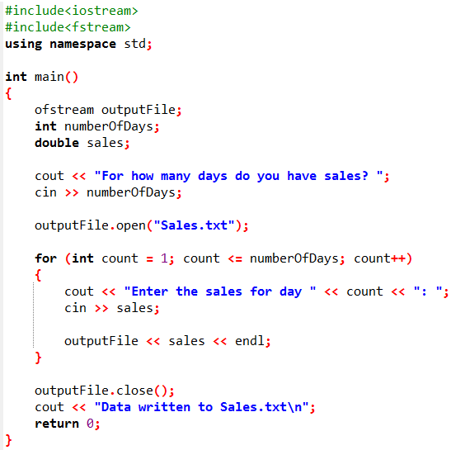
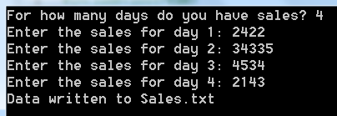
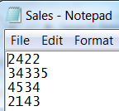
Example

Slide 15
Detecting the End of the File
Quite often a program must read the contents of a file without knowing the number of items that are stored in the file.
For example, suppose you need to write a program that displays all of the items in a file, but you do not know how many items the file contains.
You can open the file and then use a loop to repeatedly read an item from the file and display it.
However, an error will occur if the program attempts to read beyond the end of the file. The program needs some way of knowing when the end of the file has been reached so it will not try to read beyond it.

Slide 16
Detecting the End of the File
Fortunately, the >> operator not only reads data from a file, but also returns a true or false value indicating whether the data was successfully read or not.
If the operator returns true, then a value was successfully read. If the operator returns false, it means that no value was read from the file.

Slide 17
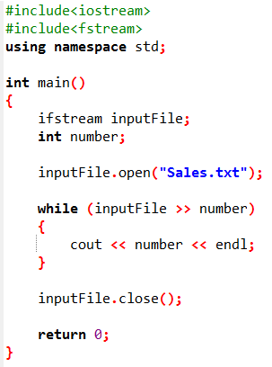

Example

Slide 18
Detecting the End of the File
Notice that the statement that extracts data from the file is used as the Boolean expression in the while loop. It works like this:
The expression inputFile >> number executes.
If an item is successfully read from the file, the item is stored in the number variable, and the expression returns true to indicate that it succeeded.
If there are no more items to read from the file, the expression inputFile >> number returns false, indicating that it did not read a value. In that case, the loop terminates.

Slide 19
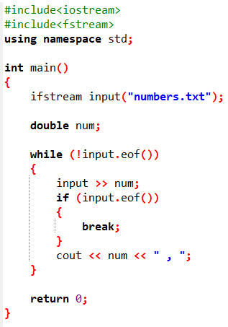
Detecting the End of the File

Slide 20

Testing for File Open Errors
Under certain circumstances, the open member function will not work.
For example, the following code will fail if the file info.txt does not exist:
There is a way to determine whether the open member function successfully opened the file. After you call the open member function, you can test the file stream object as if it were a Boolean expression.

Slide 21
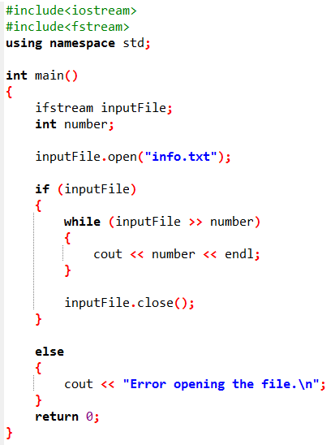

Example

Slide 22
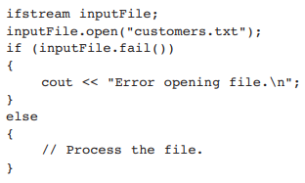
Testing for File Open Errors
Another way to detect a failed attempt to open a file is with the fail member function, as shown in the following code:

Slide 23
Letting the User Specify a Filename
In each of the previous examples, the name of the file that is opened is hard-coded as a string literal into the program.
In many cases, you will want the user to specify the name of a file for the program to open.

Slide 24
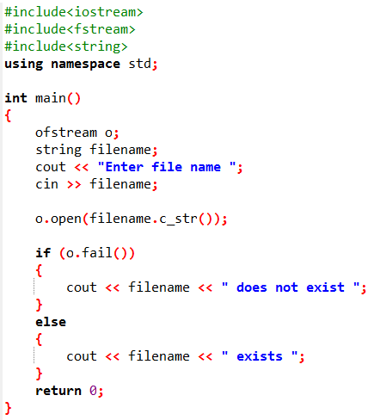
Example

Slide 25
Letting the User Specify a Filename
In older versions of the C++ language (prior to C++ 11), a file stream object’s open member function will not accept a string object as an argument.
The open member function requires that you pass the name of the file as a null-terminated string, which is also known as a C-string.
String literals are stored in memory as null-terminated C-strings, but string objects are not.
Fortunately, string objects have a member function named c_str that returns the contents of the object formatted as a null-terminated C-string

Slide 26
Next Lecture
Using the fstream Data Type
Binary Files

